Slide 1




AI TRACEFINDER: FORENSIC
SCANNER IDENTIFICATION
Presented by Jeya Mithra K

Slide 2
INTRODUCTION
Digital documents are widely used in legal, academic, and corporate systems
Forged or manipulated scanned documents are difficult to trace to their source
Every scanner introduces unique invisible artifacts such as noise, texture, and optical distortions
These scanner-specific patterns cannot be detected by human observation
There is a need for an automated system to identify the source scanner of a document

Slide 3
PROBLEM STATEMENT
The aim of this project is to identify the source scanner device used to scan a document or image by analyzing
the unique patterns or artifacts left behind during the scanning process. Each scanner (brand/model) introduces
specific noise, texture, or compression traces that can be learned by a machine learning model. This project is
important in forensic investigations, copyright authentication, and document verification tasks.

Slide 4
DATASET DESCRIPTION
Scanner-branded image dataset collected from online public sources
Scanner models included:
Canon120
EpsonV39
EpsonV550
HP
Non-scanned images collected manually from multiple online sources
Dataset organized in a class-wise folder structure

Slide 5
DATASET STATISTICS
Scanner brands: 4
DPI levels: 150 & 300
Images per DPI folder: 100
Images per scanner class: 200
Total scanner images: 800
NonScanned images: several hundreds
Total dataset size: ~1000+ images
Approximately balanced dataset

Slide 6
PREPROCESSING
Read scanned images (TIFF, PNG, JPG, JPEG)
Decode TIFF using tifffile
Convert multi-channel images to grayscale
Convert pixel values to 8-bit format
Center square crop to remove borders
Resize to 512 × 512 using area interpolation
Enhance local contrast using CLAHE
Reduce noise using Gaussian Blur (3×3)
Save optimized images for model training

Slide 7
FEATURE ENGINEERING
Extracted texture features using GLCM (contrast, homogeneity, energy, correlation, dissimilarity)
Computed features across multiple distances and angles
Encoded local noise patterns using Local Binary Pattern (LBP)
Generated normalized LBP histograms
Calculated statistical moments (mean, std, skewness, kurtosis)
Combined all features into a single feature vector for ML models

Slide 8
BASELINE MODELLING
Loaded handcrafted feature dataset from image_features.csv
Split data into 80% training and 20% testing with class stratification
Standardized features using StandardScaler
Trained Polynomial Kernel SVM for multi-class classification
Tuned hyperparameters using GridSearchCV (5-fold CV)
Evaluated model using accuracy, classification report, and confusion matrix

Slide 9
CNN MODEL
Used MobileNetV2 with pre-trained ImageNet weights
Input image size: 224 × 224
Applied data augmentation:
Horizontal flip
Rotation (±10°)
Brightness & contrast jitter
Replaced final classifier layer to match scanner classes
Loss function: CrossEntropyLoss
Optimizer: Adam (LR = 0.0003)
Best model saved based on validation accuracy.

Slide 10
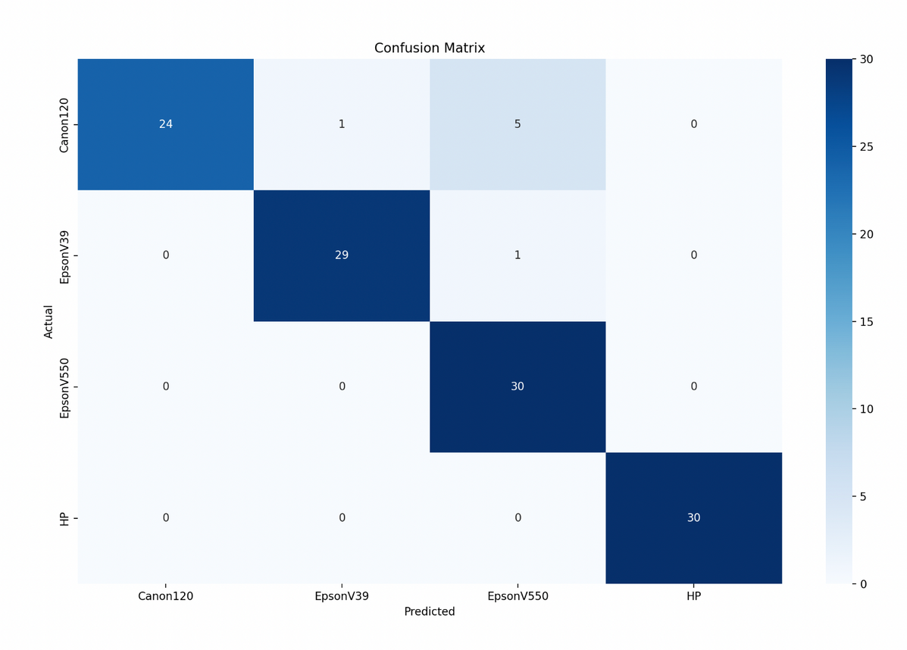
TRAINING & EVALUATION
Dataset split into 80% training and 20% validation
Trained for 15 epochs
Batch size: 32
Optimizer: Adam
Loss function: CrossEntropyLoss
Best model saved using validation accuracy
Performance measured using:
Training accuracy
Validation accuracy
Loss curves

Slide 11
WEB APPLICATION
Implemented a web-based scanner verification system
Frontend developed using Streamlit
Backend powered by trained MobileNetV2 CNN model
Accepts scanned image uploads from users
Performs real-time prediction and confidence estimation
Generates Grad-CAM visual explanations
Displays results in an interactive interface
Logs all predictions for analysis and auditing

Slide 12
CONCLUSION
Developed an AI-based system to identify scanner source from images
Implemented MobileNetV2 with Grad-CAM for explainable predictions
Achieved 95.6% classification accuracy on validation data
CNN significantly outperformed baseline approaches
Web application enables real-time scanner verification
System demonstrates practical forensic and authentication value

Slide 13
FUTURE SCOPE
Increase dataset size with more scanner brands
Include higher and varied DPI scan levels
Extend system to camera and mobile image sources
Apply transformer-based vision models
Deploy as a cloud-based forensic verification service

Slide 14
THANK
YOU

